Slide 1
EnhanceBiz

Slide 2
Index
01
EnhanceBiz Induction
02
Presence, Clients , language and skillset
03
Technology Overview
04
Business Proposal

Slide 3

Introduction
EnhanceBiz is a technology led BPO organization with customer centric approach. We enhance customer satisfaction for client through customer experience management and digital transformation solutions powered by AI, ML. We are an impact sourcing organization which works in T2 & T3 cities, largely for woman employment.
EnhanceBiz provides omni-channel/multi-channel digital customer experiences across all channels – voice, e-mail, chat, social media, annotation, transcription and data digitization.
Mission: To drive technology led company that transforms business process by meeting client’s goal we drive with creating opportunities for youth, Women, differently abled and financial backward candidates in Tier three cities.
Vision: We will be most reliable business partner globally
Core Values: Integrity, Empathy, Ownership,

Slide 4
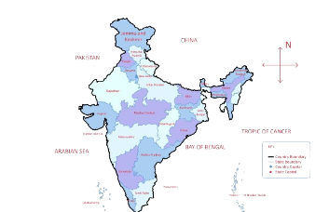
Presence
Presence
Location : Four locations in India while one office is based in New Jersey USA.
Clients & Skillset worked
Proposed Location
Mohali
Ranchi
Kolkata
Data Annotation
2D, 3D ladder segmentation
Transcription
E- Commerce
Edutech

Slide 5
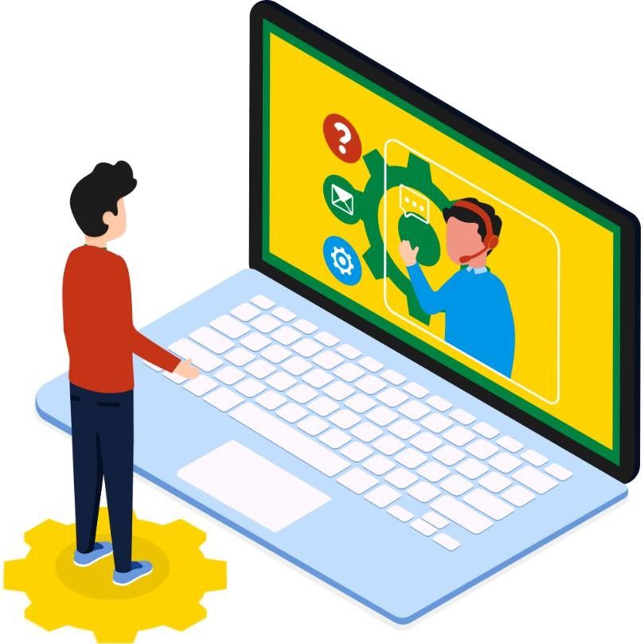
Technology Overview
Contact Centre Suite
Advanced Contact Centre Suite with a state-of-the-art ACD &
Dialer, Call Recording, and Preview/Predictive Dialing Options.
Robust Infrastructure
Advanced terminals with noise-cancelling headsets, a next generation application, database & voice servers – all within a professional contact centre environment.
Reports & Analytics
In-depth, yet easy-to-interpret reporting capabilities – to help monitor agent performance, analyses call volumes and provide Six Sigma-oriented call quality management.
Technical Integration
As discussed in initial talk for this process we will go for toll free number, PRI, Dialler, System, network connectivity & Advisor support.

Slide 6
Capabilities
Sales and Insurance
Pre-Sales and Sales
New Business
On-Boarding & Support
Policy Services
Claims Support
Sales Campaign Management
Inbound and Outbound Sales Support
Relationship Building with Decision Maker
Take Information to Quote
Quote
Negotiate and Reach Agreement
Quote Acceptance
Application Completed
Cross Sell/Up Sell
Application review and Documentation Check - KYC
Coordinate for additional documents / complete Application Form
Engage with and support Client stakeholders on decision making
Confirmation on Acceptance / Decline of Insurance request
Policy Issuance
Customer Support for New and Existing Customers
Endorsements / Amendments
Customer Correspondence
Manual / Exception Processing
Retention Process
Coordination for Revised Quotes and Policies
Renewal Policy Issuance
First Notice of Claim
Coverage Verification and Claims Registration
Claims Review and Decision Making
Setting-up Reserve Process
Assign Repair Garage &
Field Adjuster
Confirmation of processing through Work Orders
Claims settlement

Slide 7

Services Offered
AI-powered Customer Experience Products
Contact Center Solutions
EnhanceBiz (Subscription based call center)
AI Chatbot
AI Avatars
Lead Generation Tool
IQA (Intelligent Quality Auditor)
Speech Analytics
Customer Acquisition
Customer Onboarding
360° Customer Experience
24x7 FAQ based call center
24x7 Live chat support
24x7 AI based chat support
AI voice bot-based call support
Email Support
Chat Support
Voice Support
Catalogue Management
Outbound sales
Backend Support
Robotic Process Automation
Customer Lifecycle Management Advisory
1. Human Capital Development Suite
2. Quality Assurance & Compliance Mastery
Cross Sell/Up Sell
Customer Retention
Business Intelligence
IT Helpdesk
Staff Augmentation
Integrated Administrative Solutions
3. Operational Excellence Hub
4. Optimized Workforce Management

Slide 8
Process flow - Sales / Retention /Onboarding
Prospect Customers
Advisors/dialer will dial to all the customer Leads
Connected calls
Not Connected calls
Conviencing Customers on program / Retention offer pitching and register CRM/ info
Not connected calls will be called 3 times to connect
Final SaleConversion will be moved to payment system / website/ link OR Rentention will be updated to the team with pitched offer

Slide 9
Commercial Proposal
Pricing per FTE model : TBD for 192 hrs / 24 days
Scope of delivery : TBD
Location : Ranchi, Jharkhand
Head | Scope
People | EnhanceBiz
Ops Governance &Physical Infra, Internet, | EnhanceBiz
Data , Tool and CRM | Clients
Support Staff ( TL,QA,AM,Managers) | EnhanceBiz
Terms:
EnhanceBiz may provide 100+ FTE Ramp up in 30-40 days time.
Billing as per MSA GRID (SOW yet to receive)
Training will be provided by client (SOW yet to receive)
Training duration as per client SOP
Working Window for IB / Outbound / Retnetion calling – 10am – 7pm (6 days) or 24*7
Language for support– English & Hindi
Cloud Telephony, if required shall be billed separately.
All other terms to be discussed and mutually agreed by both parties

Slide 10

Thank You
EnhanceBiz

